Slide 1
INTRO

Slide 2
1.7 BILLION WEBSITES EXIST TODAY!

Slide 3
OVERVIEW
Engineering progression
Full-stack introduction
Full-stack history
Class topics
Syllabus
Demographics
About the professor

Slide 4
ENGINEERING PROGRESSION

Slide 5
ENGINEERING PROGRESSION

Slide 6
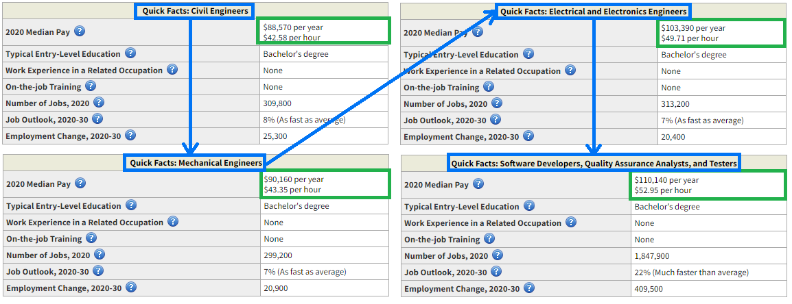
EVIDENCE OF PROGRESSION

Slide 7
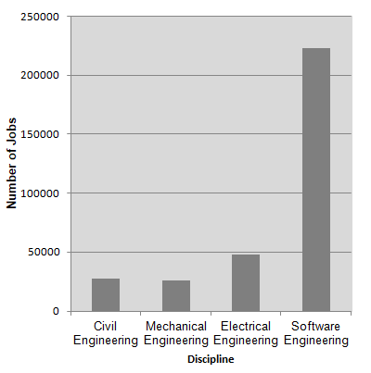
JOB DEMAND

Slide 8
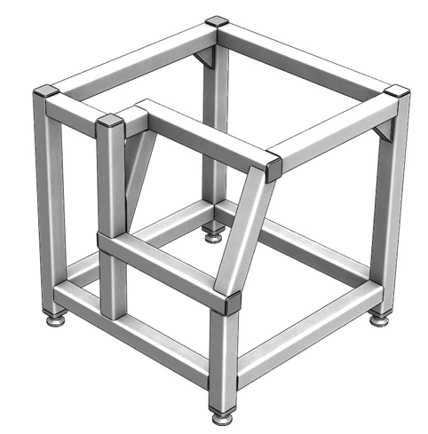
WELDMENTS

Slide 9
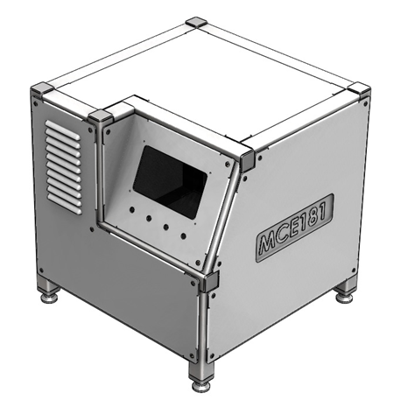
SHEET METAL

Slide 10
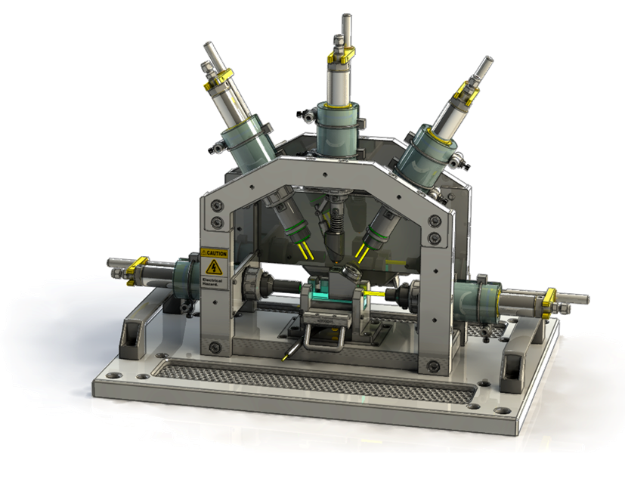
FIXTURES

Slide 11
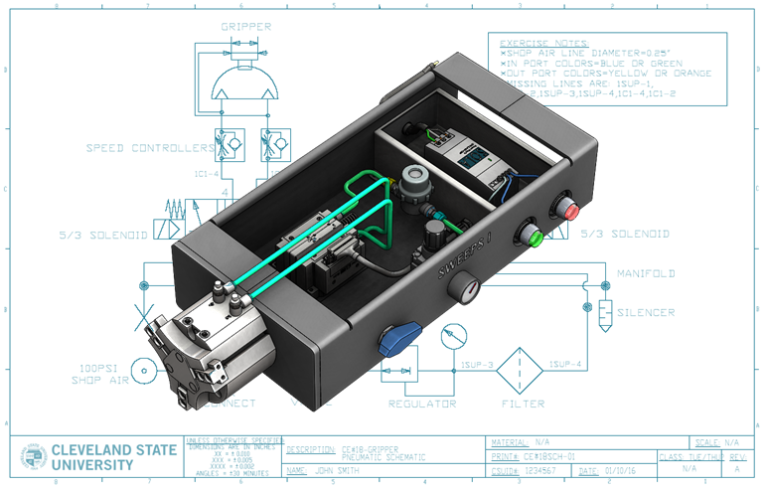
FLUID POWER

Slide 12
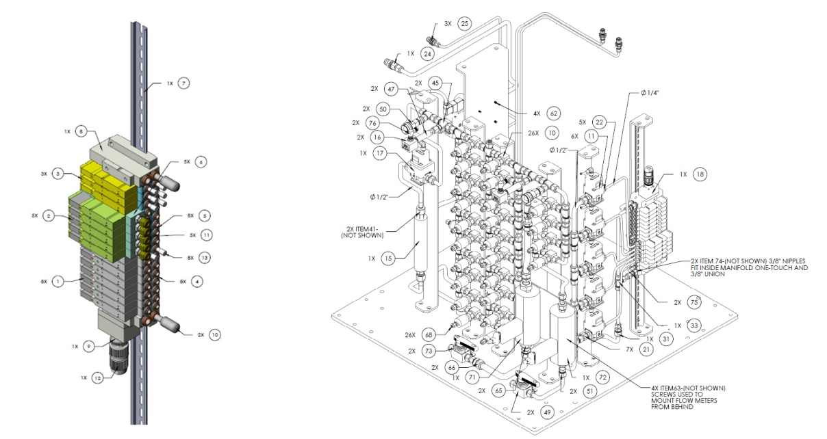
FLUID POWER

Slide 13
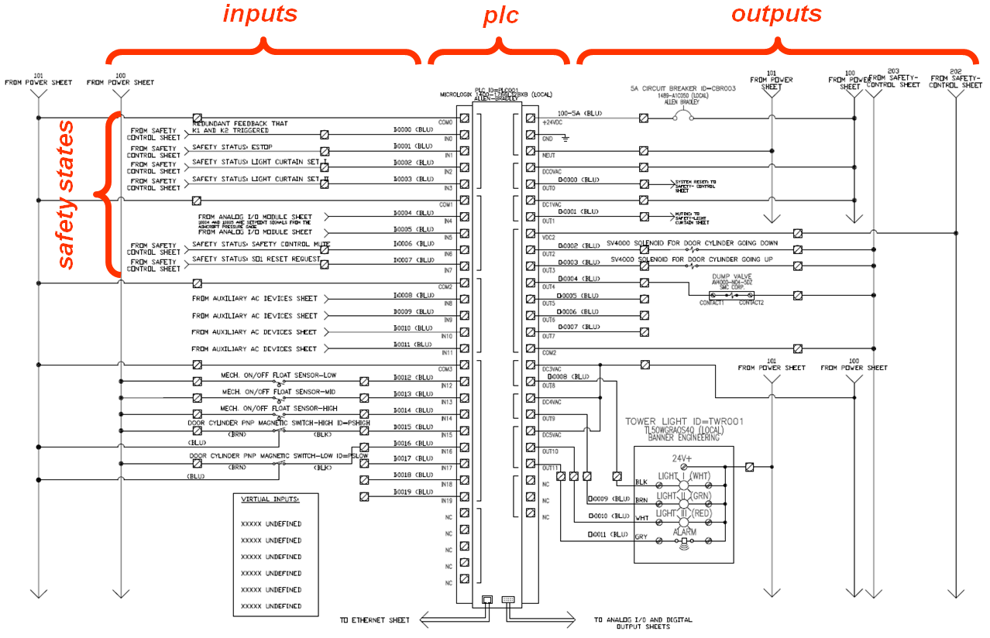
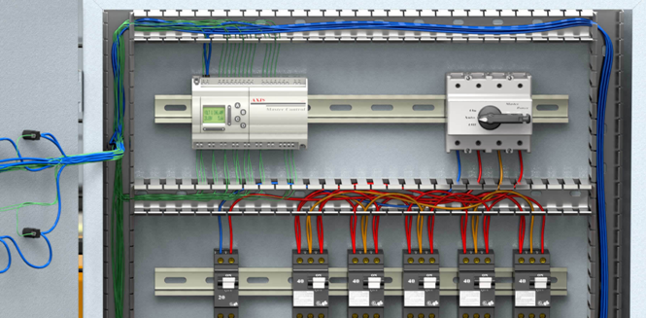
ELECTRICAL

Slide 14
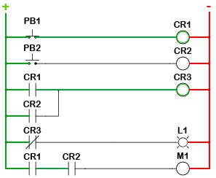
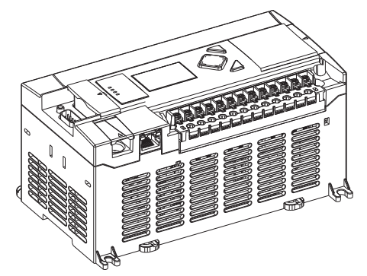
PROGRAMMING

Slide 15
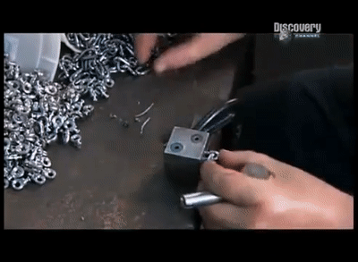
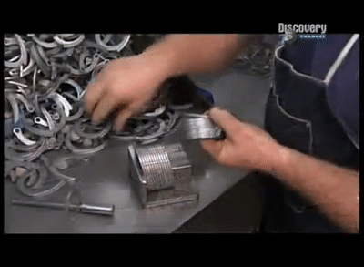

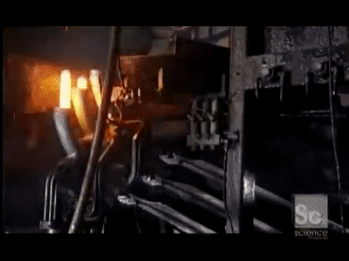



Slide 16
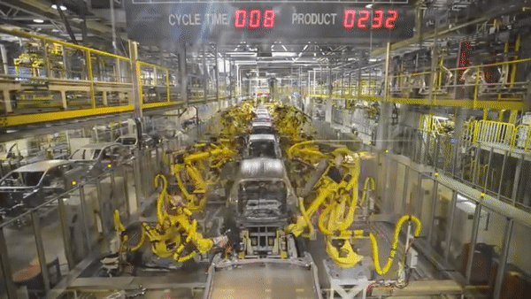

Slide 17
SEQUENCE
Every machine, vehicle, skyscraper, organism uses the same architecture to function.
The brain controls the nervous system, the nervous system controls the muscles, and the muscles control the skeleton.
Software is the last stage in all design systems. It is the brain where the psychology is defined.
It is more complicated/difficult to design the brain than it is to design the skeleton.
Engineers need to update their skills in order to stay competitive.
The farther away you get from hardware, the better off things get.

Slide 18
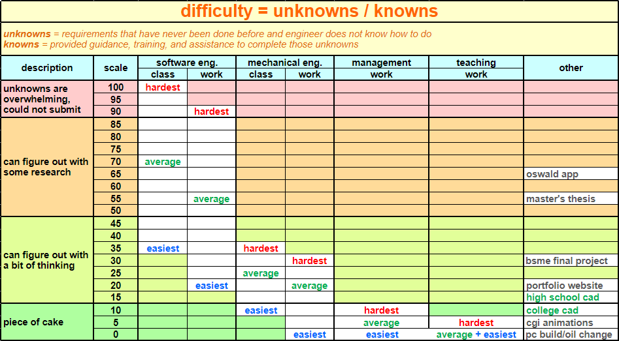
SCALE OF DIFFICULTY

Slide 19
EDUCATION
Class | Profession | Description | Education Level | Years of Education | Hourly Pay | Automated Estimate (as of the 21st century)
suit-and-tie | the researcher | can understand and design, but also discover new knowledge like electricity or e=mc^2 | phd | 22 | $$$$$ | 0%
white collar | the designer | can understand existing knowledge and apply it to design a system | master’s | 18 | $$$$ | 0%
 | the office associate | can understand existing knowledge and support it | bachelor’s | 16 | $$$ | 5%
blue collar | the technician | can do manual labor based on complex instructions | associate’s degree | 14 | $$ | 10%
 | the laborer | can do manual labor based on simple instructions | high school diploma/GED | 12 | $ | 50%

Slide 20
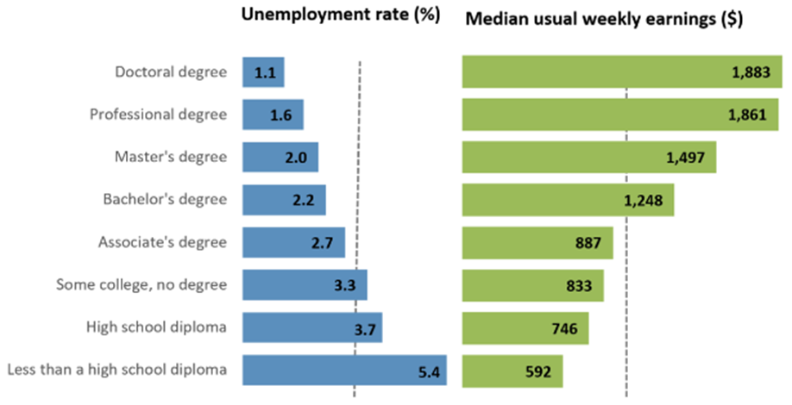
KNOWLEDGE IS KEY

Slide 21
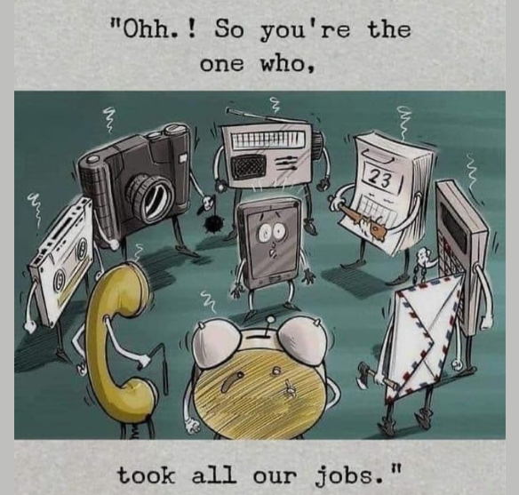
EDUCATION
There used to be a day where high school was not free.
There used to be a day where being able to read and write was considered educated.
In order to stay competitive, more knowledge and education is required to maintain the systems to make our lives easier.
Lower level tasks are being automated by machines.

Slide 22


Slide 23
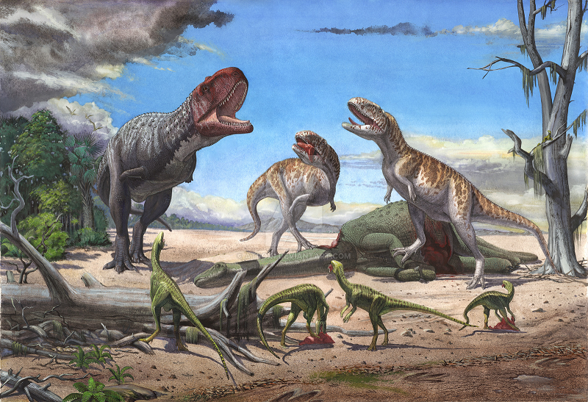
PROGRESS IS VOLUNTARY
Progress can only happen when associates have a drive for change.
The dinosaurs lived for 165 million years, but still could never figure out how to use or invent tools.

Slide 24
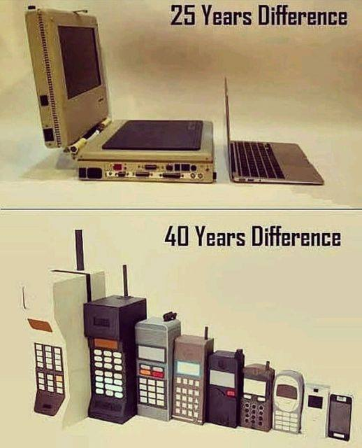
PROGRESS IS VOLUNTARY

Slide 25
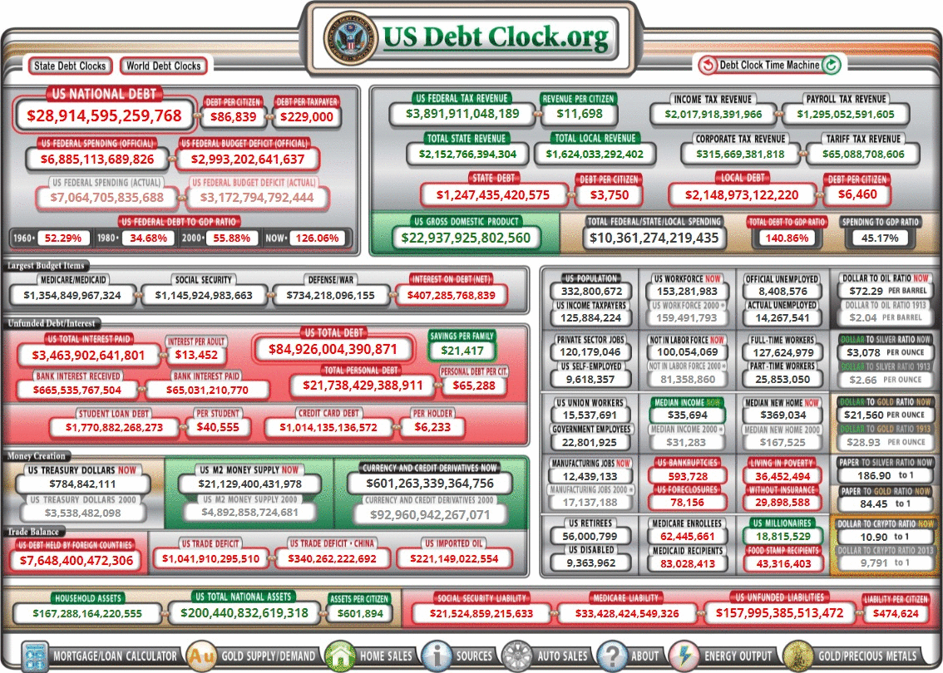
LISTENING TO THE CUSTOMER

Slide 26
FULL-STACK INTRODUCTION

Slide 27
WHAT ARE FULL-STACK APPLICATIONS
Applications are used to store user input into a database and display it in such a way that is presentable.
Full-stack dynamic applications can save data to a database whereas front-end static websites are only informational and do not retain data.
Any app that requires a create account/login is a full-stack app.
Full-stack apps are often used for data/document management, invoicing, budgeting, scheduling, data analytics, auto-grading, medical coding, messaging, and many others.
Computers are not very intelligent but they can complete many simple tasks very quickly.
In this century, you can not stay competitive without software.

Slide 28
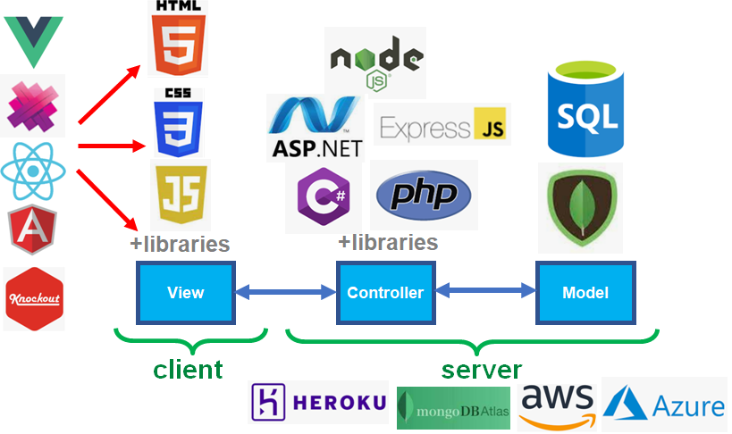
FULL-STACK TECHNOLOGY SNAPSHOT

Slide 29
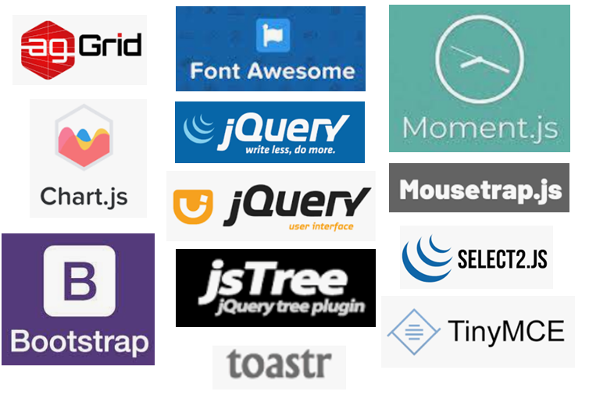
LIBRARIES

Slide 30
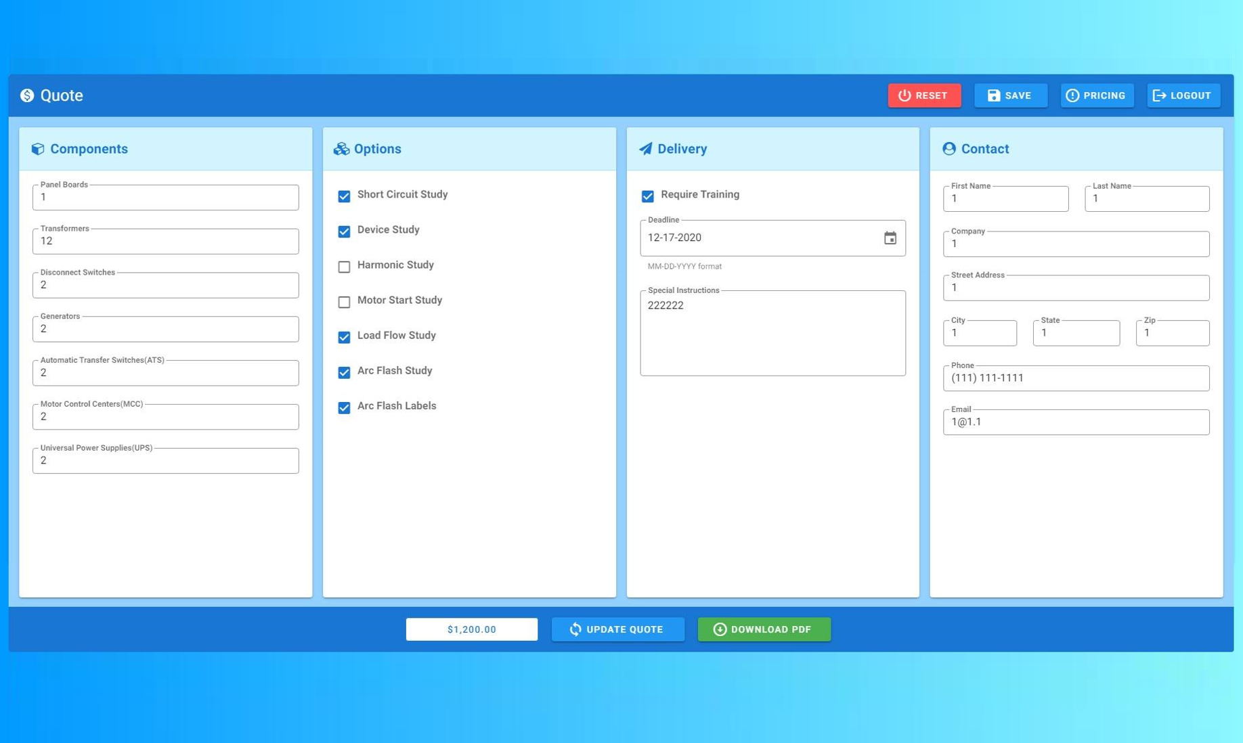

Slide 31

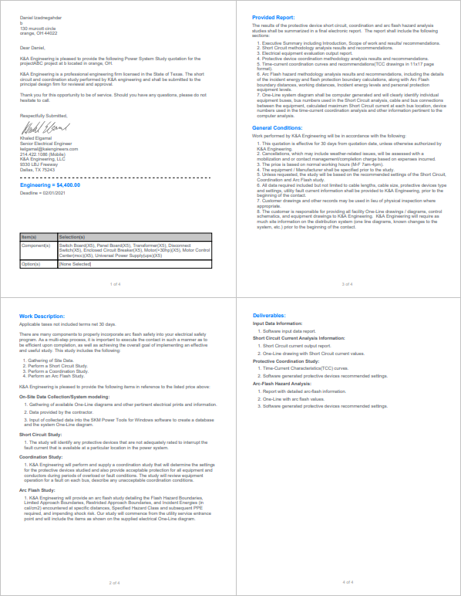

Slide 32
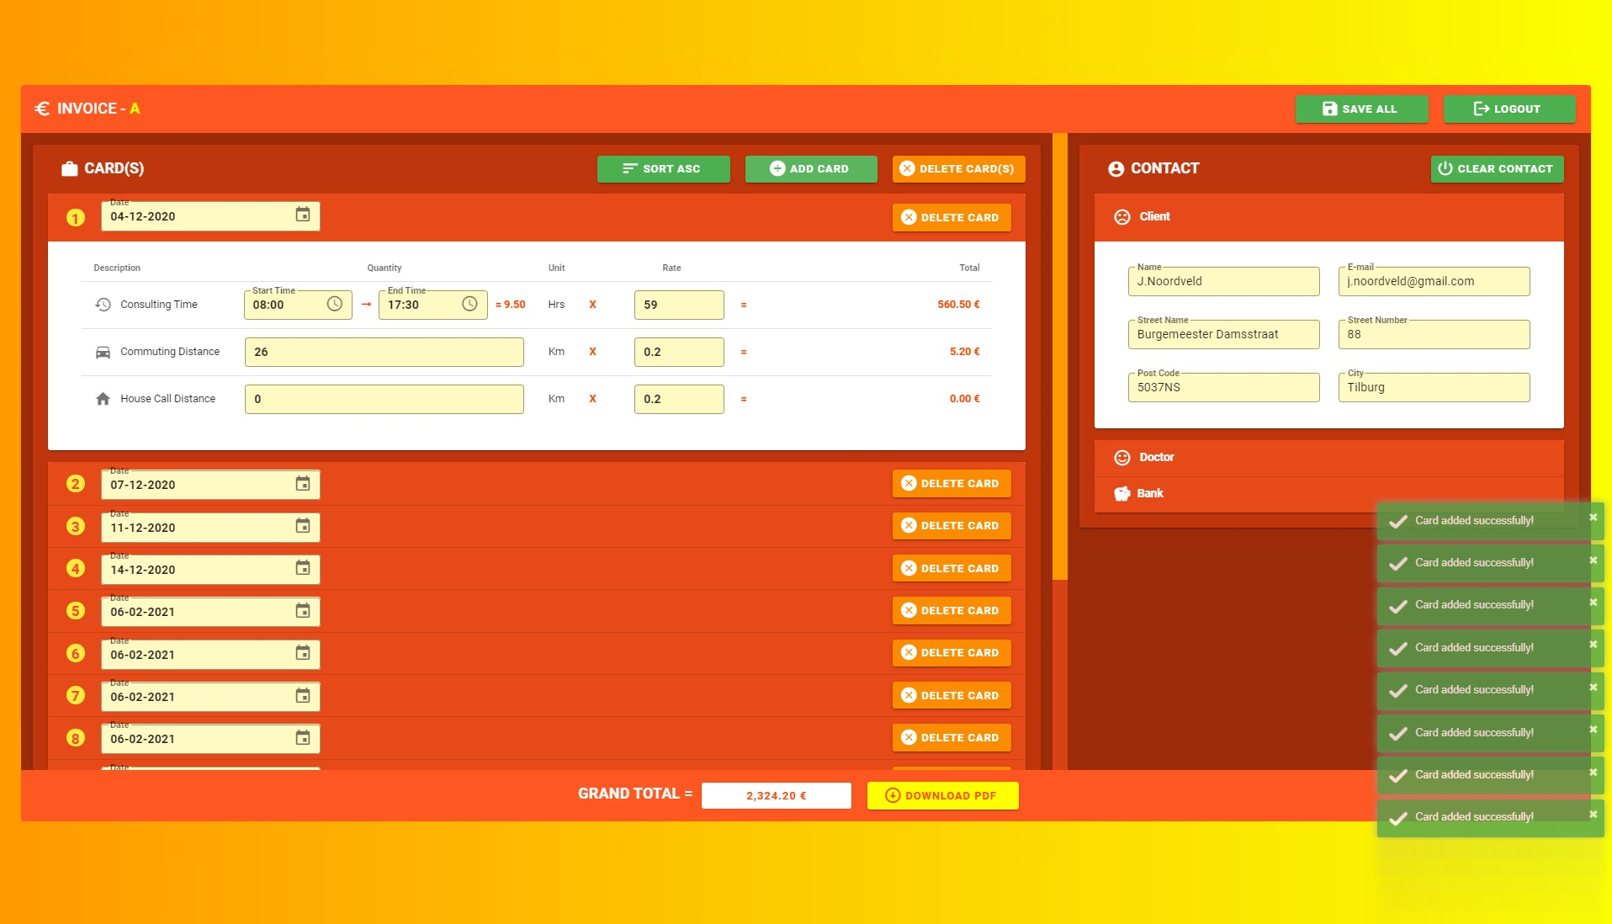

Slide 33
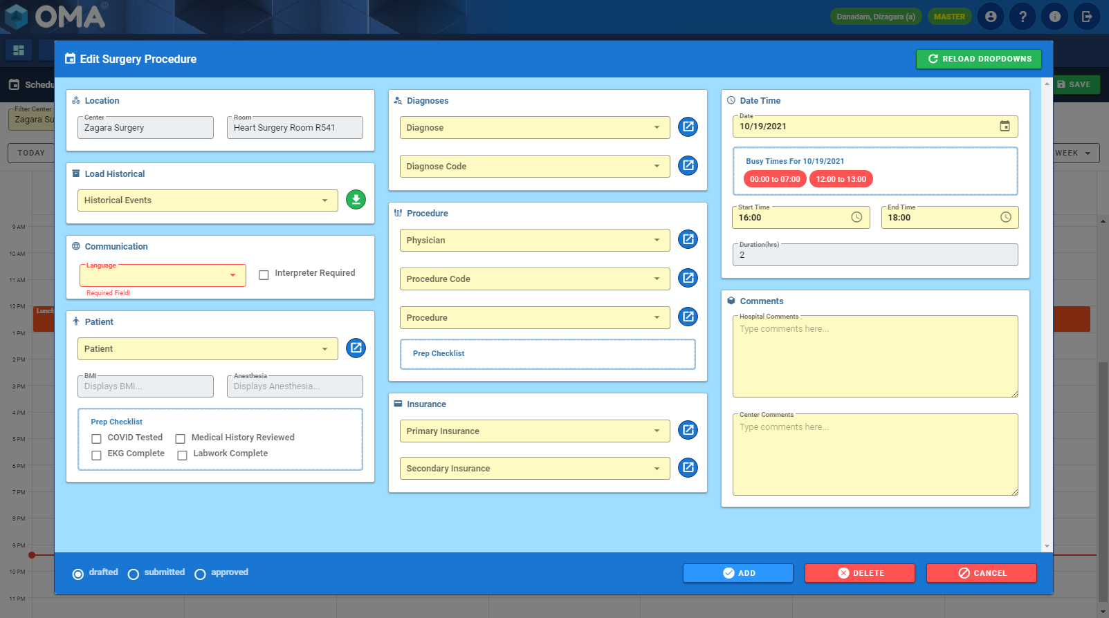

Slide 34
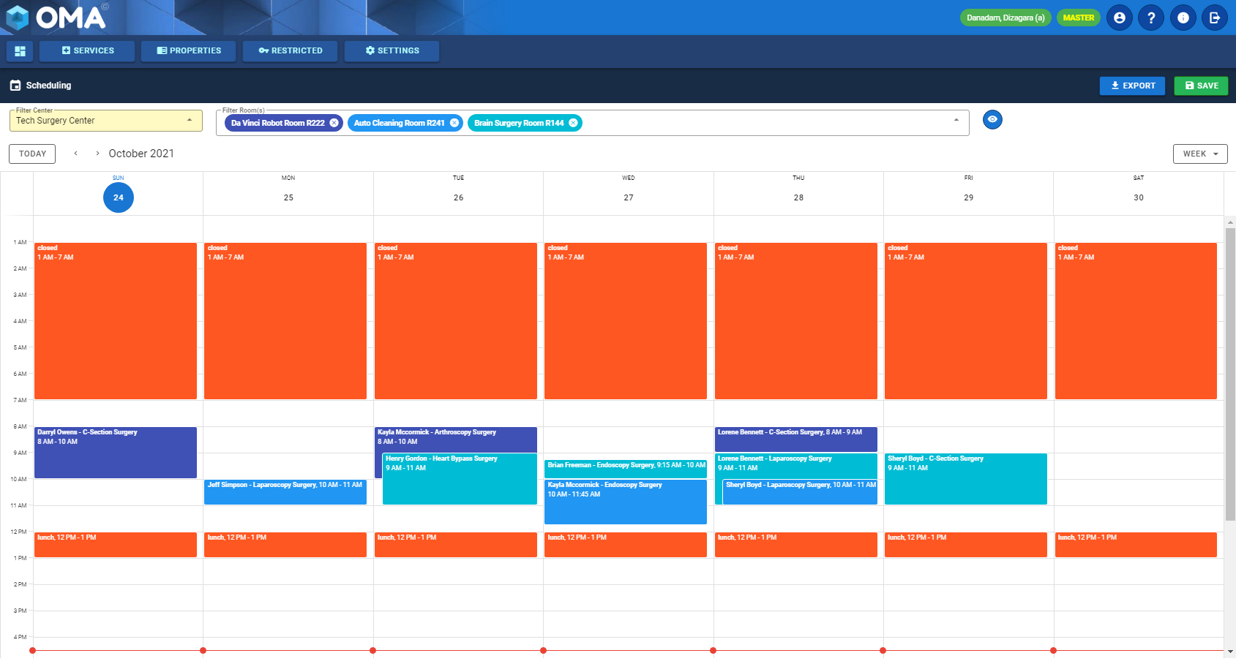

Slide 35
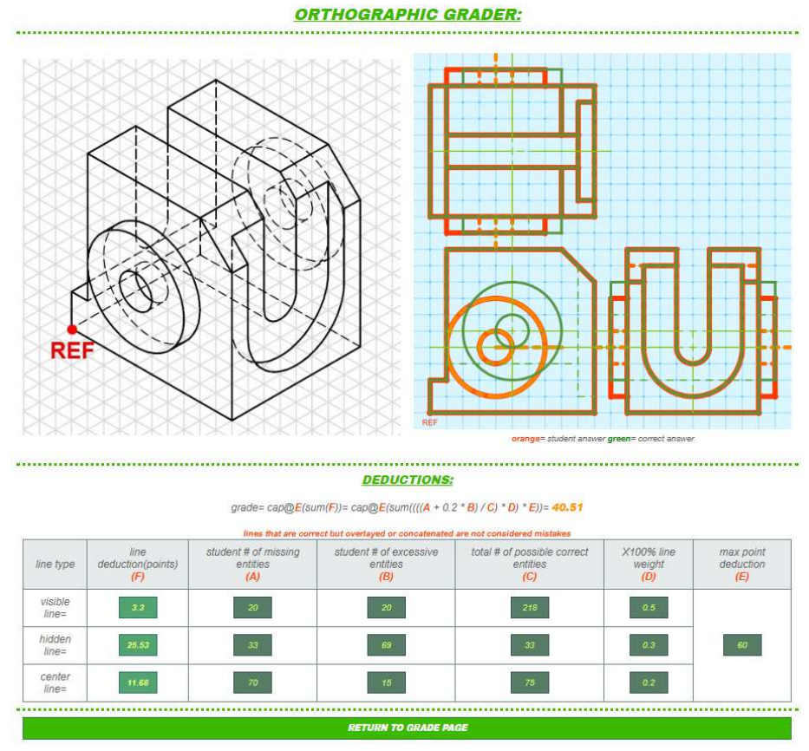
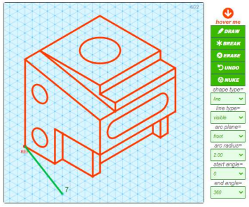

Slide 36
FULL-STACK HISTORY

Slide 37
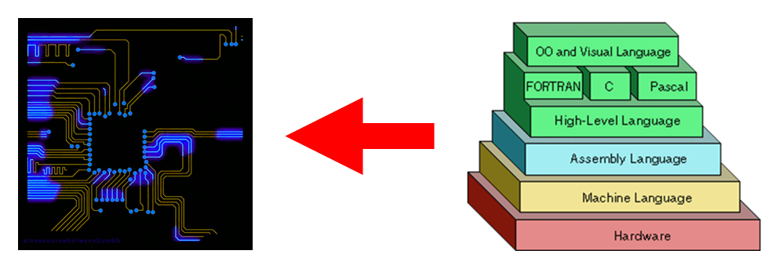
THE LAYERS
CPUs only understand 0s and 1s at the lowest level.
The purpose of software is to write 0s and 1s as easily as possible.
Engineers are usually hired to program lower level languages(JavaScript) as opposed to higher level languages(Excel or WordPress).
The lower you go on the layers, the more money you will make.

Slide 38
VISUAL BASIC
In the early 1990s, many early applications used MS Visual Basic(VB) and were mainly desktop applications.
VB was one of the first packages that allowed programmers to add customizable input controls like dropdowns, textboxes, and checkboxes that can all be customized with programming.
The problem with these early applications built with VB is that they required installation, they only lived on local computers, and could not be accessed on the internet.

Slide 39
WEB FORMS
In the early 2000s, Microsoft made an attempt to build a framework that allowed programmers to build applications that can be deployed on the internet.
They called this new framework, Web Forms, and used a similar architecture to VB.
Web Forms was a step above VB because it included added functionality for the client-server model, taking advantage of HTML, CSS, Javascript, C#, and SQL into a graphical user interface similar to VB.

Slide 40
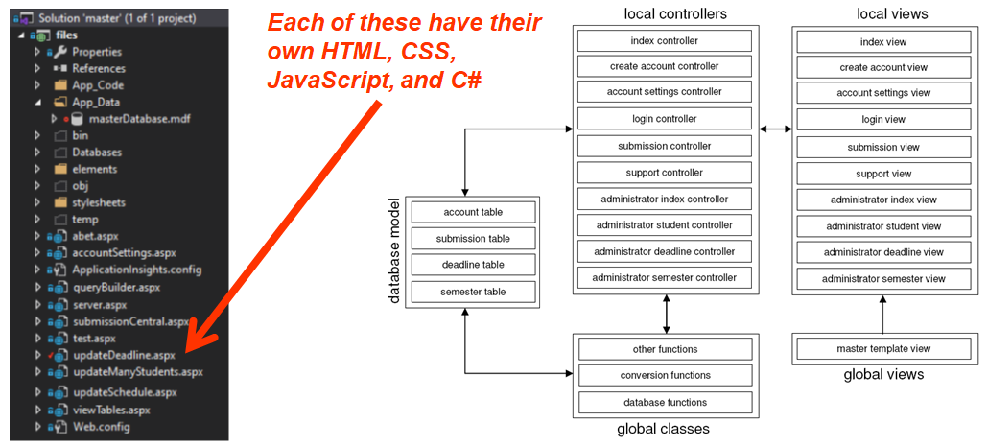
WEB FORM ARCHITECTURE

Slide 41
SINGLE PAGE APPLICATIONS(SPA)
The problem with Web Forms is that they were slow, because every page was treated like a new website.
This is why the Single Page Application(SPA) framework was introduced in the mid 2000s. This architecture uses a powerful framework that can combine and merge components into a single page that gets re-written locally on a needed basis, instead of doing a fresh reload.
These SPA frameworks include React, Vue, or Angular.
These frameworks have become increasingly popular on many job descriptions.

Slide 42
CLASS TOPICS

Slide 43
FRONT-END TOPICS
HTML language
CSS language
JavaScript language
Libraries(JQuery, Moment, Toastr, Boostrap,…etc.)
Frameworks basics(React, Vue, Angular,…etc.)
Frameworks advanced(templating, compartmentalization, repeaters, binding, life cycles, apis, event aggregators,…etc.)

Slide 44
BACK-END TOPICS
API development
Node, C#, Express controllers
MongoDB database systems
SQL database systems
Complete full-stack project

Slide 45
OTHER TOPICS
Notepad++, Visual Code, Visual Studio IDEs
Data visualization concepts
Testing and debugging methods
Azure/AWS deployment concepts
Version control and documentation
Design considerations (compatibility, readability, security, performance, concurrency, responsiveness)

Slide 46

LEARNING IS LIKE A TREE
The process of learning is the process of building a tree of the new skill set to learn.
A poor instructor will review a series of sporadic leaves and branches to bulid the tree, whereas a good instructor will follow a coherent sequence of reviewing the trunk, the branches, and the leaves.
An intelligent person is able to build this tree with whatever instruction they are given.

Slide 47
SYLLABUS

Slide 48
LOGISTICS
Class# : CSDS221 - Full Stack Web Development
Credit Count: 4
Prerequisites : None
Room: TBD
Times: Mon (7:00p – 9:30p) + Wed (7:00p – 9:00p)

Slide 49
GRADING

Slide 50
SUPPLIES
Laptop that is not apple product.
E-mail account with google drive.
(optional) Textbook (fundamentals of web development, 3rd edition).

Slide 51
POLICIES
No cheating allowed, code must be original.
See academic calendar for withdrawal dates.
Late penalty is 15% per day for homework.
Exams are not accepted late.
Exams are closed book and closed notes.
A valid excuse must be provided for extensions.

Slide 52
SCHEDULE

Slide 53
PEOPLE
Professor:
Daniel Izadnegahdar(Dan), archive.master.apollo@gmail.com
Teaching Assistant(s):
Viet Dinh(Viet), vhd8@case.edu
Xuecen Zhang(Xu), xxz1037@case.edu
Trung Nguyen(Trung), tnn18@case.edu

Slide 54
DEMOGRAPHICS

Slide 55
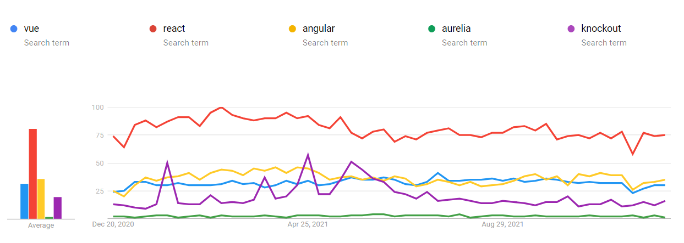
TOOL POPULARITY

Slide 56
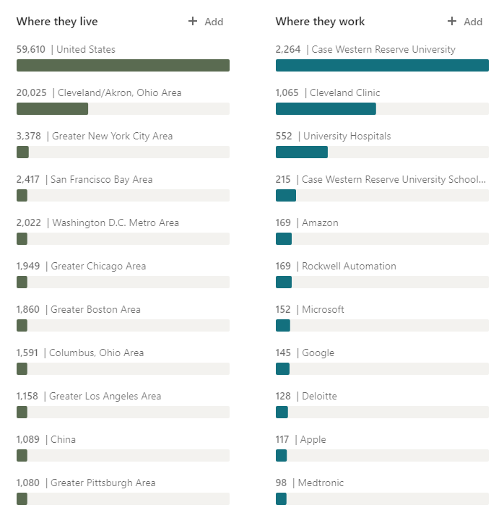
WHERE CWRU GRADS END UP

Slide 57
THE RANKS
Profession | Salary | Years Experience | Job Description
Architect | $120k | 10+ | Can coordinate software projects between different developers and provide direction on architecture and design of software applications
Senior | $100k | 6-10 | Can build a full-stack app as well as a series of interconnected micro-services
Mid-Level | $80k | 4-6 | Can build a full-stack app from scratch
Junior | $60k | 2-4 | Can complete feature requests on their own
Intern | $40k | 0-2 | Can complete feature requests with a lot of guidance

Slide 58
ABOUT THE PROFESSOR

Slide 59
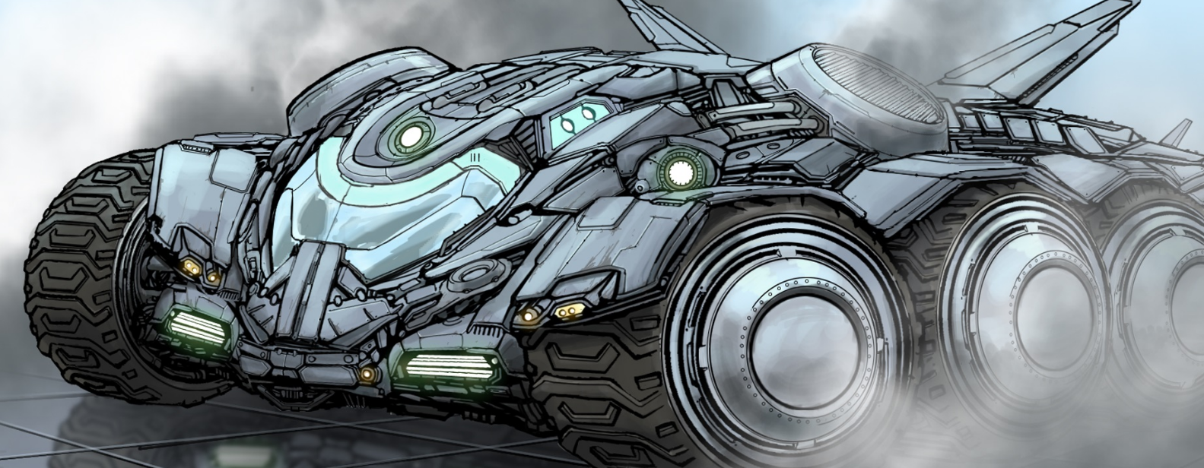
2D/3D ANIMATION
Worked as illustrator, graphic designer, and eventually 2D/3D animator for 3 years.
Work was broadcast on local television, corporate summits, and training videos.
Used Flash, Maya, Photoshop, After Effects, Premiere, and VFX plugins.

Slide 60
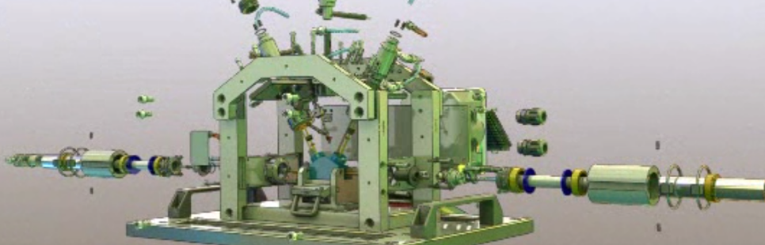
MECHANICAL ENGINEERING
Worked as a mechanical engineer for 10 years.
Designed mechanical, pneumatic, hydraulic, and electrical systems for assembly and test equipment.
Designed over 700 parts and drawings for fixtures, weldments, and sheet metal with Solidworks.
Designed electrical and P&ID schematics with AutoCad.
Programmed plcs and hmis using RsLogix500 and FactoryTalkView.
Coordinated technician effort to take machines from concept to release.

Slide 61
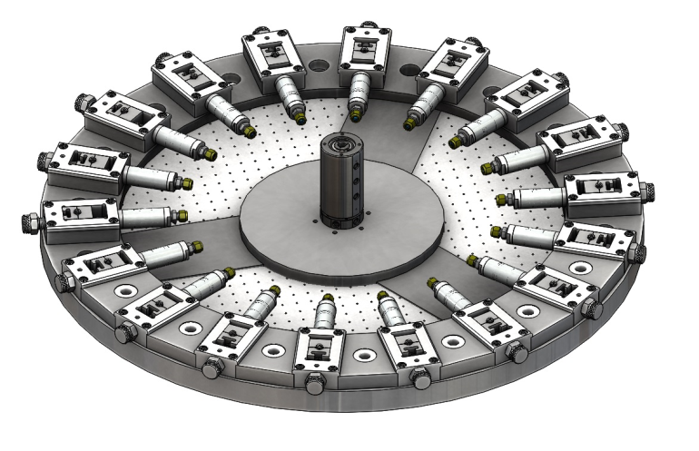
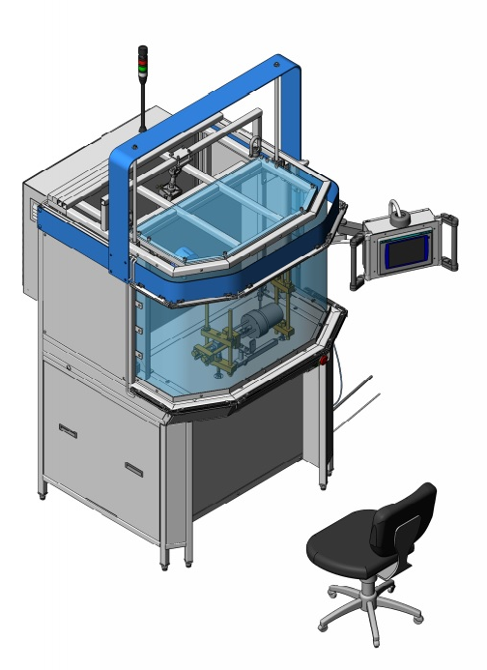
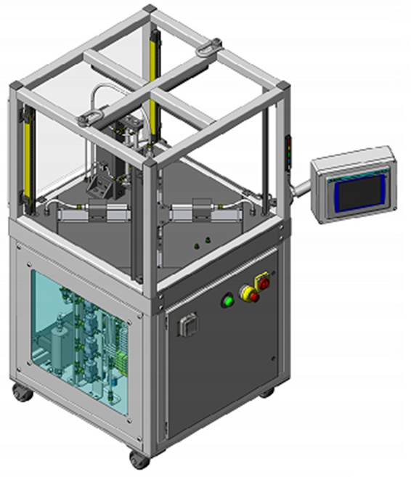
MECHANICAL ENGINEERING

Slide 62

SOFTWARE ENGINEERING
Worked as a software engineer for 5 years.
Designed 7+ full-stack apps for various industries.
Designed and maintained all aspects of frontend and backend.
Developed algorithms, database aggregates for various applications including automated reporting, virtualization, and OCR.

Slide 63
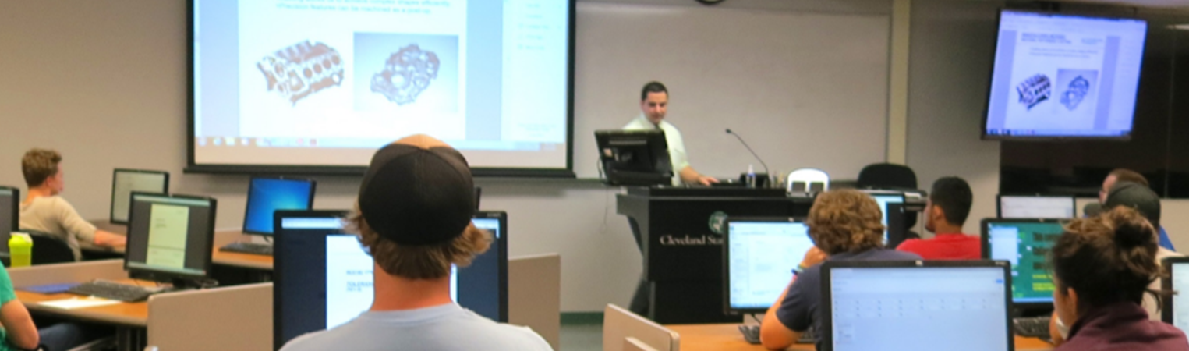
TEACHING
Taught STEM courses for 6 years at universities in Ohio.
Taught 150 - 250 students per semester, 3 semesters a year, and managed 2 - 3 teaching assistants per semester.
Designed 4 courses, textbooks, slide decks, lectures, videos, apps, assignments, and exams.

Slide 64
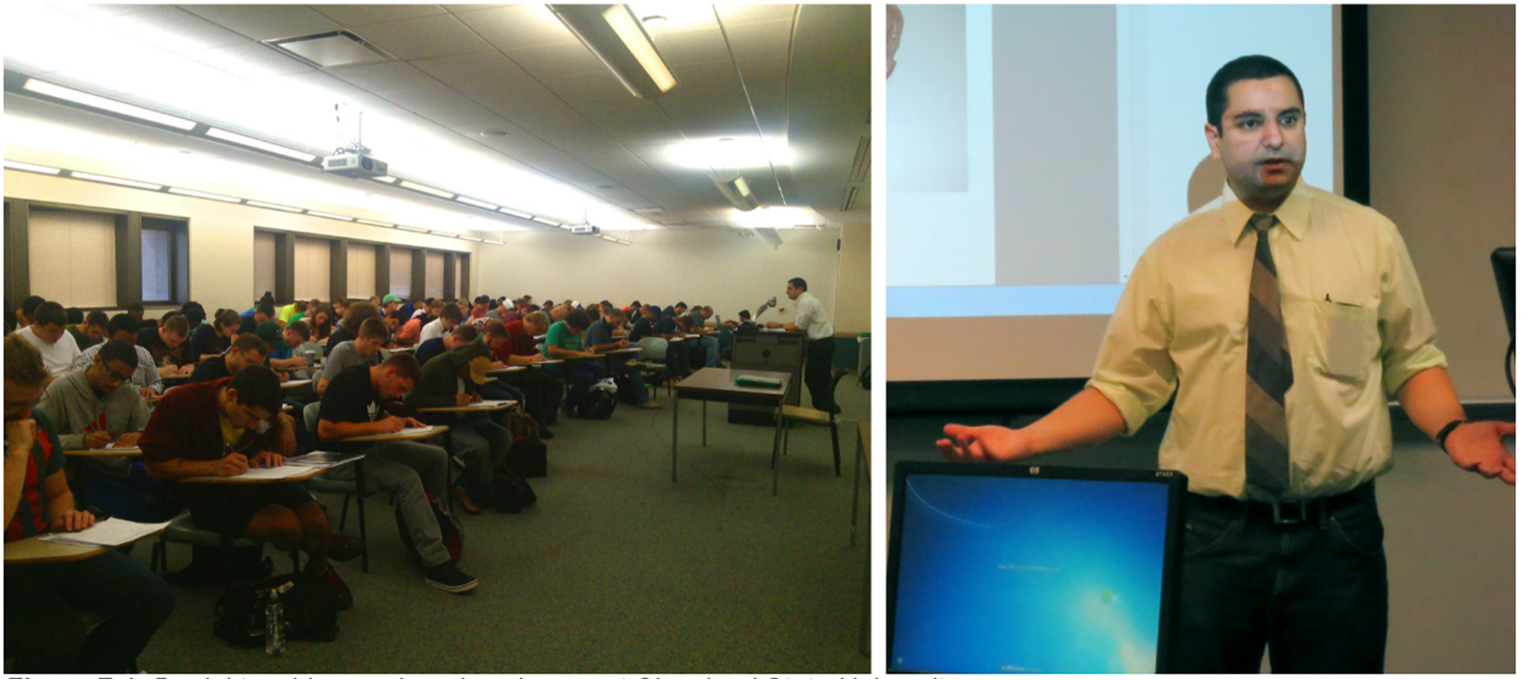

Slide 65
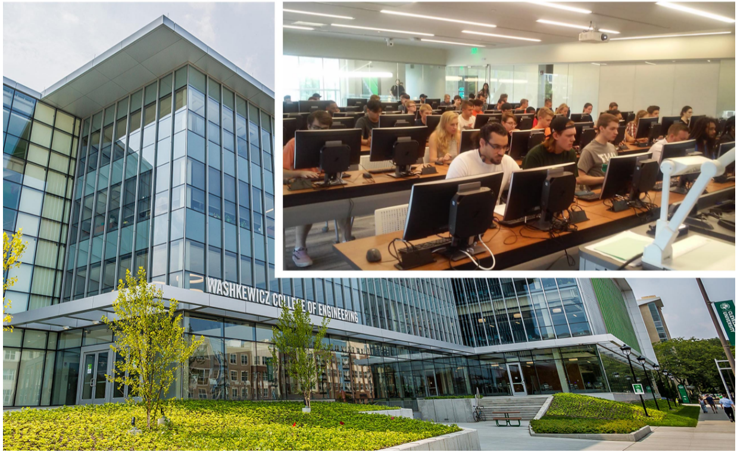

Slide 66
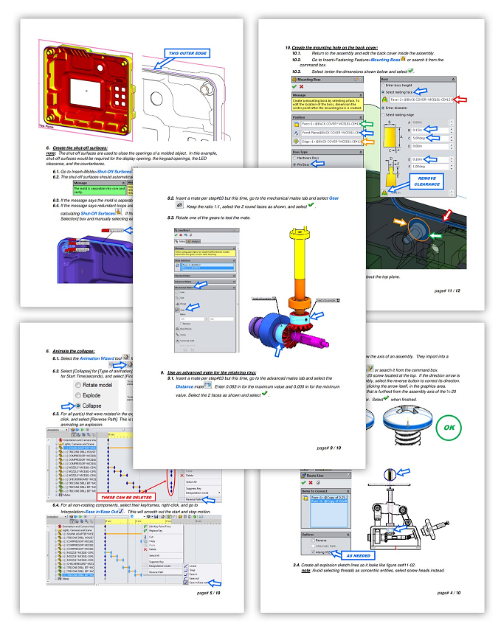
TEXBOOK
Created over 200 pages of instructional material that were designed specifically for the class duration and schedule of the course.
Designed the sequence of instruction from part to assembly, and weldment to completed machine.
It took 2 years to complete writing this book.

Slide 67
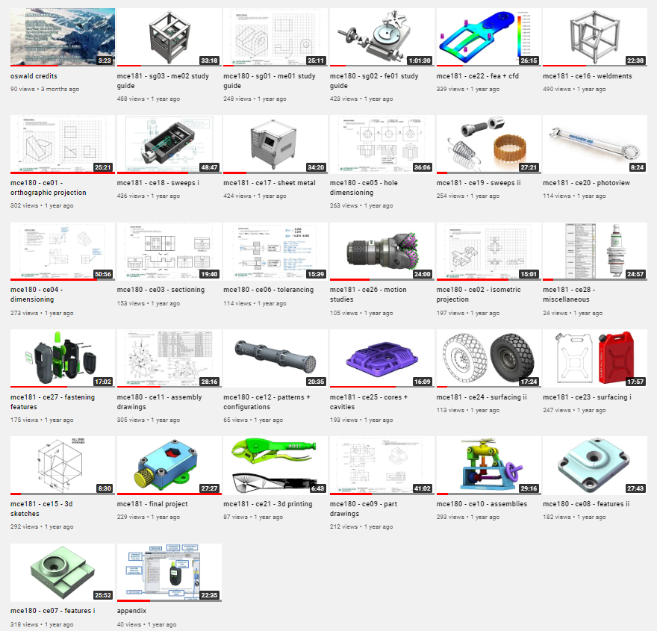
VIDEOS
Created over 25 hours of instructional videos to assist students who could not attend class during the lockdown.
Each video required design of material, recording, compositing, editing, and deployment.
It took 3 months to complete these videos.

Slide 68
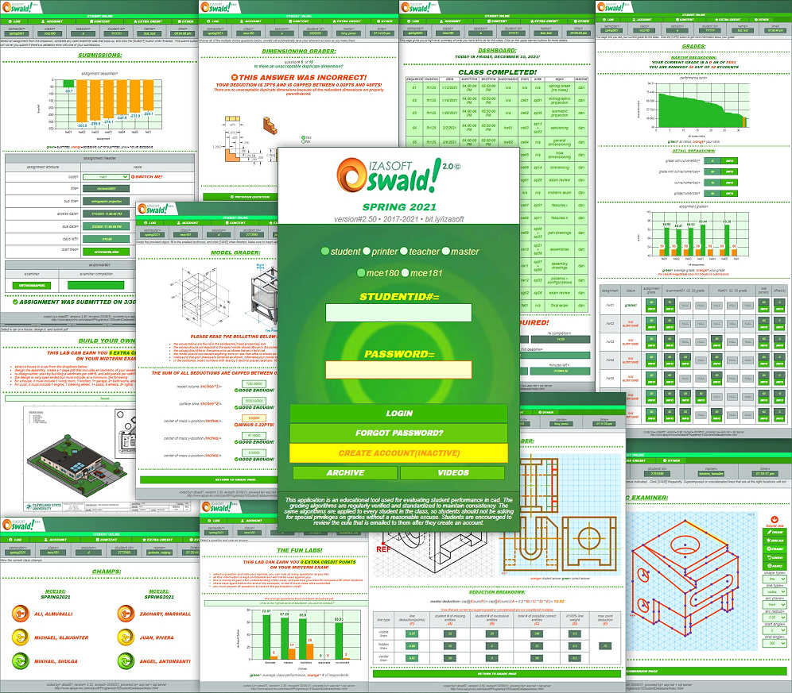
APPLICATION
Oswald had the ability to run a large class fully autonomously, meaning after spending 30mins of setup before each semester, no other administrative work was required by the professor or TAs.
Oswald could auto-schedule, auto-grade, auto-group, without any exchange of emails, files, or printouts.

Slide 69
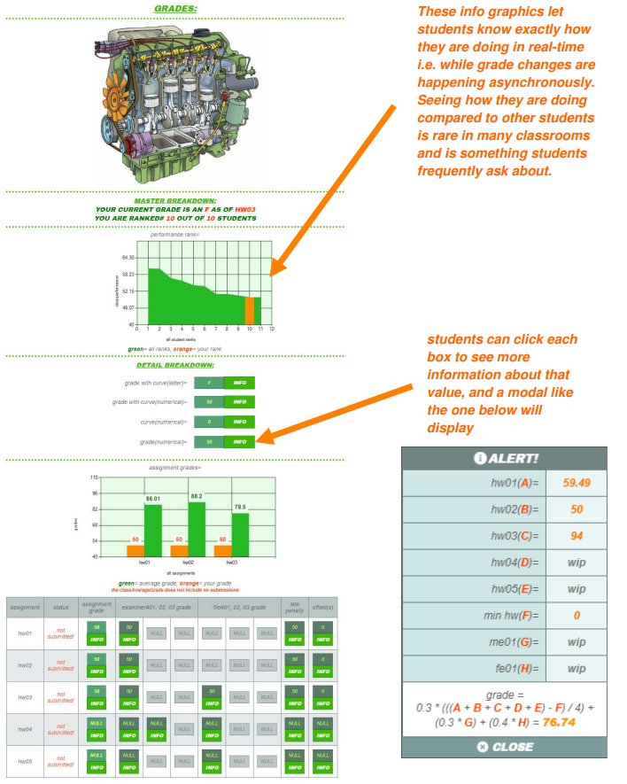
APPLICATION
Oswald could grade data entries, multiple-choice, pdf files, SolidWorks models, and cartesian CAD drawings.
Cheating was controlled by using different questions and params for each assignment. When an account is created, it randomly fetched different questions from a master archive.
Final grade sheets were not only consistent with the grades students received in high-school, but they also matched the same bell curve of previous semesters where grades were done manually.
It took 3 years and 50k lines of code to complete Oswald.

Slide 70
ACCREDIDATION
Frontend web development certificate.
Data visualization web development certificate.
BSME(BS Mechanical Engineer).
MSME(MS Mechatronics Engineering)(embedded software focus).
MCIS(MS Computer & Information Science)(ERP software focus).

Slide 71
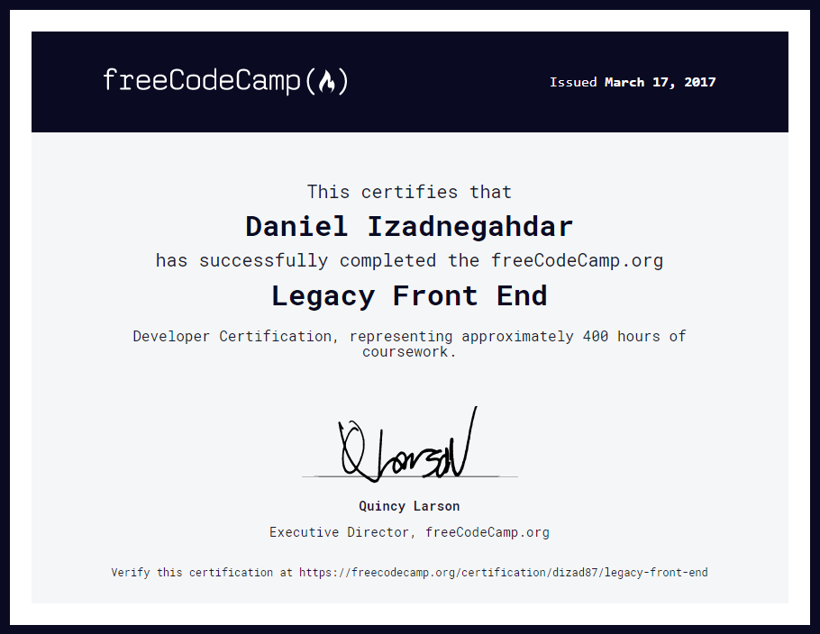

Slide 72
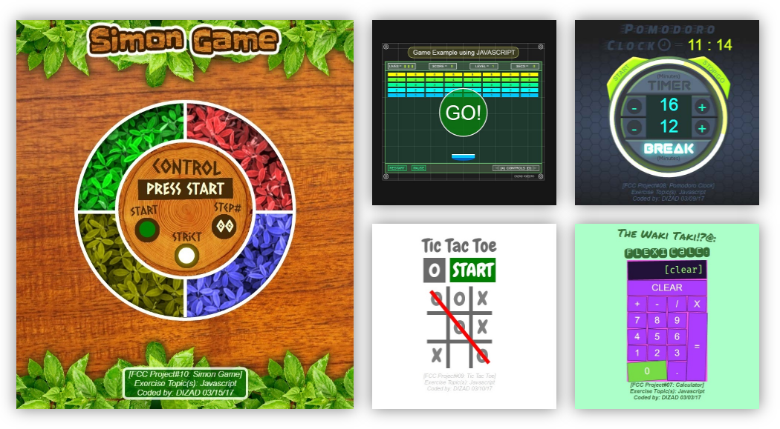

Slide 73
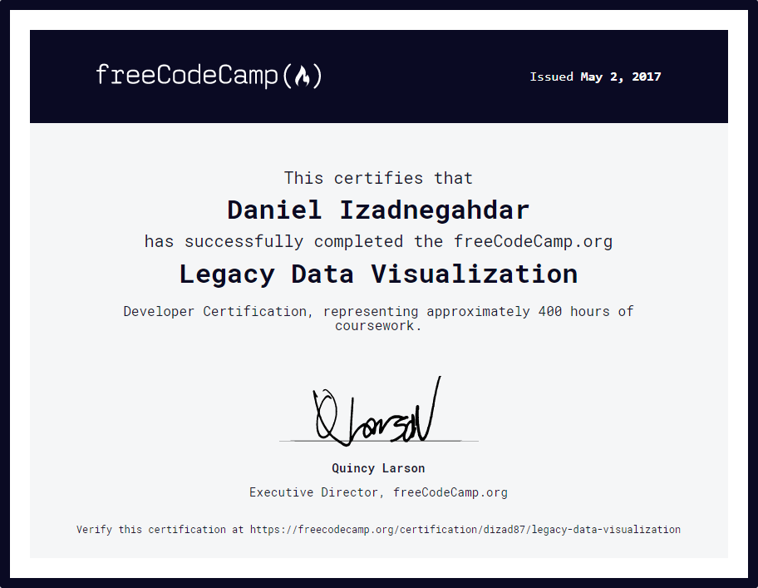

Slide 74
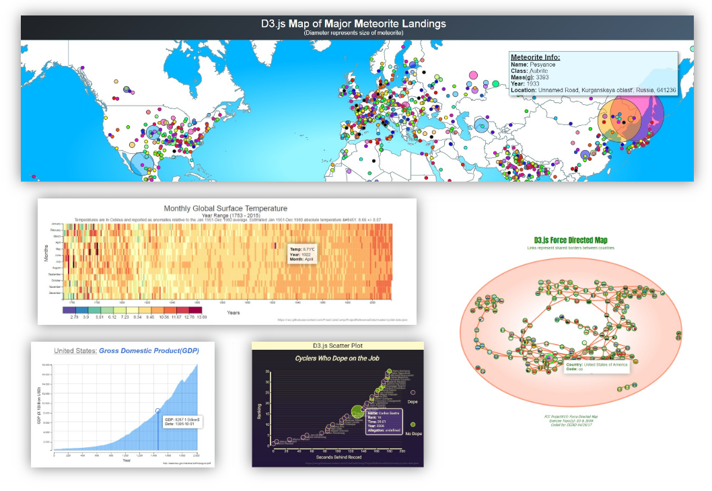

Slide 75


Slide 76


Slide 77



